Slide 1
Research Question
Databases continue to grow every day, and how they are handled becomes a more and more important issue. That's where sorting algorithms come into play. They are a crucial role in managing data, especially while working with large datasets. In this experiment, the goal is to determine which of five different sorting algorithms can organize a numerical list most efficiently and effectively based on speed. I predict that Quick Sort will probably be the best at sorting lists the fastest. And by comparing these algorithms, I learn info about which algorithm can sort a numerical list the fastest under different conditions, such as different list sizes and data distributions.

Slide 2
Notation and Framework
To conduct my research, I created several example sets to test each algorithm. The lists will have a range of different unsorted numerical values. Then I will sort the list using each algorithm a total 10 times to get steady range of results. Lastly I will average the results to get my final piece of data so I can reach my conclusion.

Slide 3
Data Analysis
I discovered that Quick Sort sorted all the lists - both big and small - the fastest out of any of the algorithms used in the experiment. Some of the more complicated ones like Insertion Sort and Selection sort took as long as 3 seconds or longer to sort the bigger lists. The last two algorithms (Merge and Heap Sort) took a moderate amount of time to sort the lists and had similar results when put side by side.

Slide 4
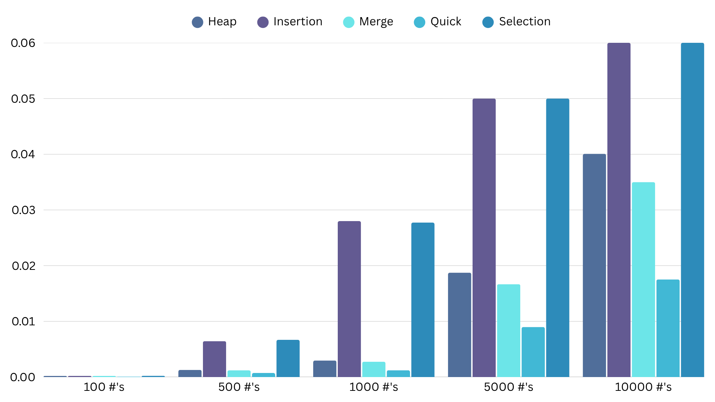

Slide 5
Conclusions
These results prove that my hypothesis is correct, but also answers others questions. This info determines that certain algorithms like Insertion and Selection Sort shouldn’t be the first choice for large data sets. Some things I could have done better is using broader and larger data sets next time if I were to continue this project.

Slide 6
References
CodersLegacy. “Comparison of Sorting Algorithms.” 17 June 2021, https://coderslegacy.com/comparison-of-sorting-algorithms/. Accessed 1 October 2025.
Finio, Ben. “What's the Fastest Way to Sort a List?” 24 June 2025, https://www.sciencebuddies.org/science-fair-projects/project-ideas/CompSci_p002/computer-science/programming-a-simple-alphabetizer. Accessed 1 October 2025.
“4.4 Sorting Algorithms.” https://www.computersciencecafe.com/44-sorting-algorithms.html. Accessed 1 October 2025.
LibreTexts. “4.2: Activity 2 - Sorting Algorithm.” https://eng.libretexts.org/Bookshelves/Computer_Science/Databases_and_Data_Structures/Data_Structure_and_Algorithms_(Njoroge)/04%3A_Searching_and_Sorting_Algorithm/4.02%3A_Activity_2_-_Sorting_Algorithm. Accessed 1 October 2025.
“2.3. Sorting.” https://www.csfieldguide.org.nz/en/chapters/algorithms/sorting/. Accessed 1 October 2025.

